Slide 1
Lecture 1
Introduction to computer vision

Slide 2

To see
“What does it mean, to see? The plain man's answer (and Aristotle's, too). would be, to know what is where by looking.”
To discover from images what is present in the world, where things are, what actions are taking place, to predict and anticipate events in the world.

Slide 3
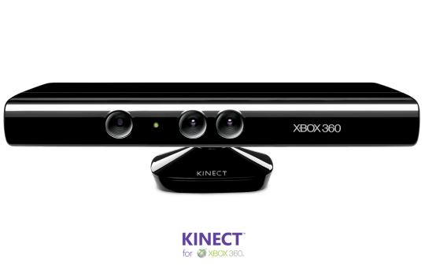
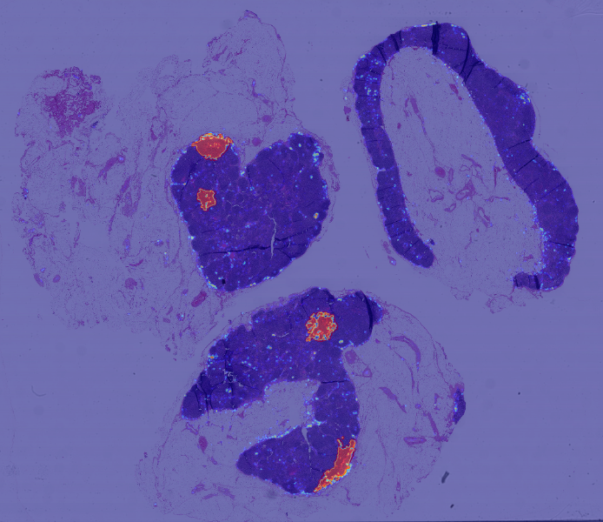
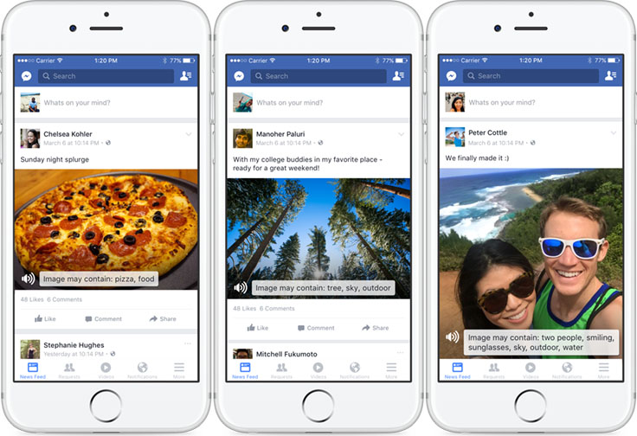
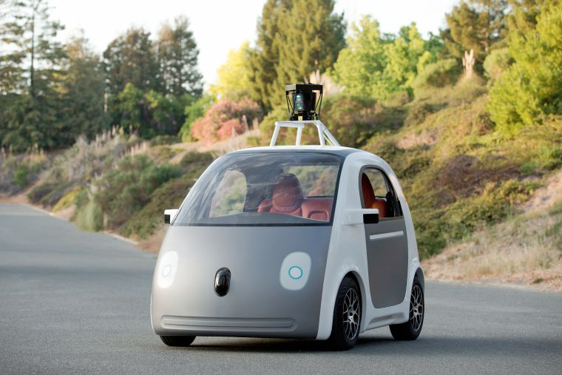
Exciting times in computer vision
Robotics
Gaming
Medical applications
Driving
Accessibility

Slide 4
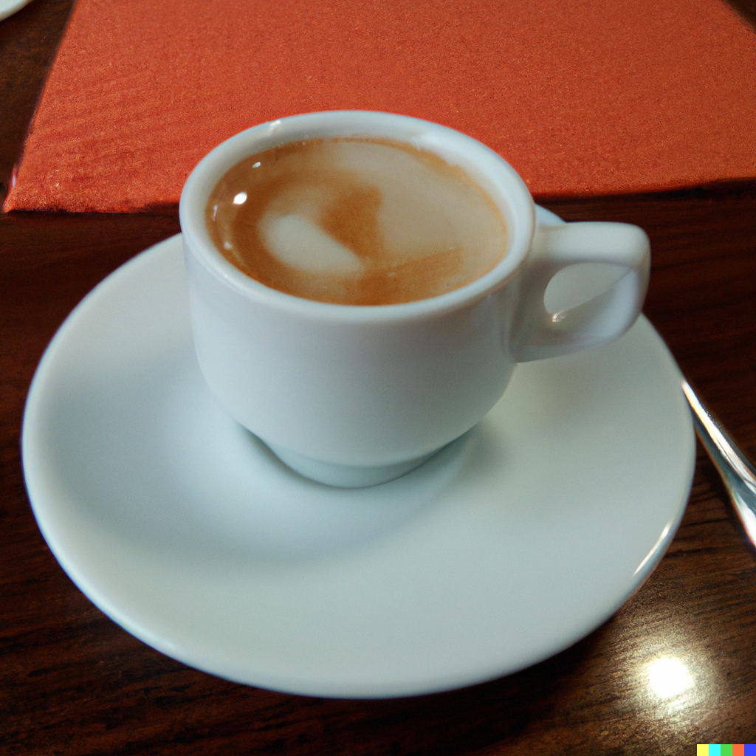
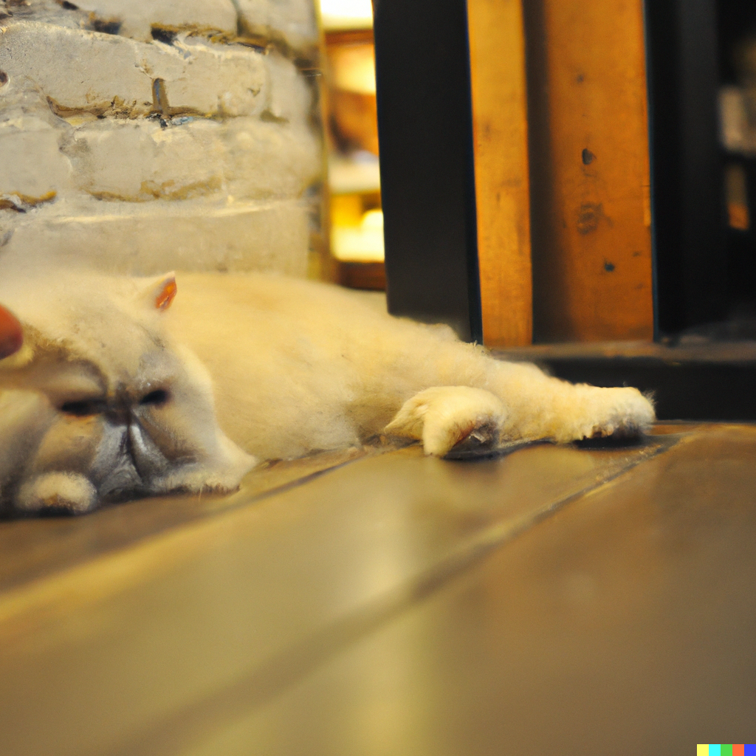
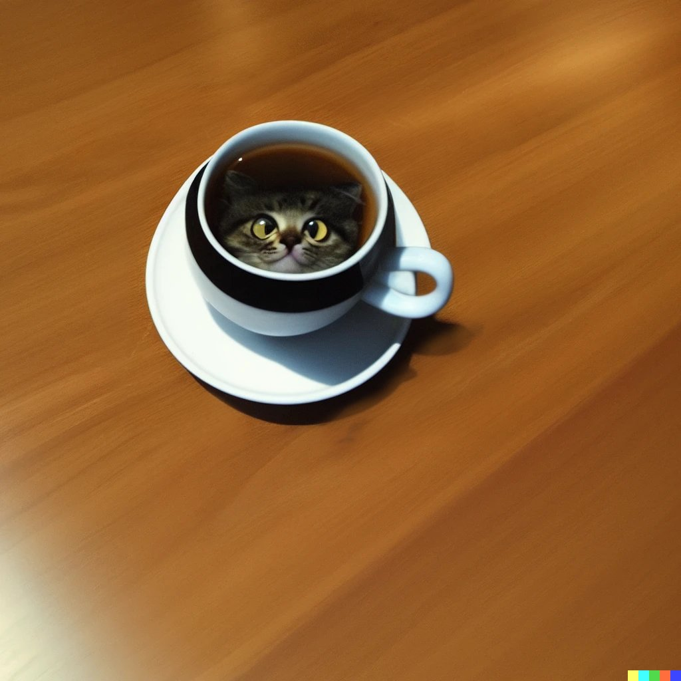
Exciting times in computer vision
“A cup of coffee”
“A cat”
“A cup of cat”
DALL-E 2 (Open AI)
https://www.reddit.com/r/dalle2/comments/y4mygn/a_cup_of_cat/
Slide credit: Shuang Li
Notes:
One aspect that makes these models so powerful is their ability to recombine concepts to create new things.
For example, given a new text input ‘a cup of cat’, DALLE-2 can generate an image containing both the cup and cat. This ability, which we call compositionality, is the key force behind the creativity (and originality) of such models.
%
first show the caption, and then show the image
a cup of coffee, a cat, a cup of cat
emerged sometimes, but this is
show the caption first, and then show the image
show multiple images and this are not cherry picked

Slide 5
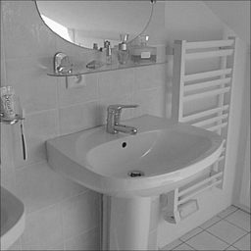
When some of us started…
Airplane
Sheep
Bed
Horse

Slide 6
Why is vision hard?

Slide 7
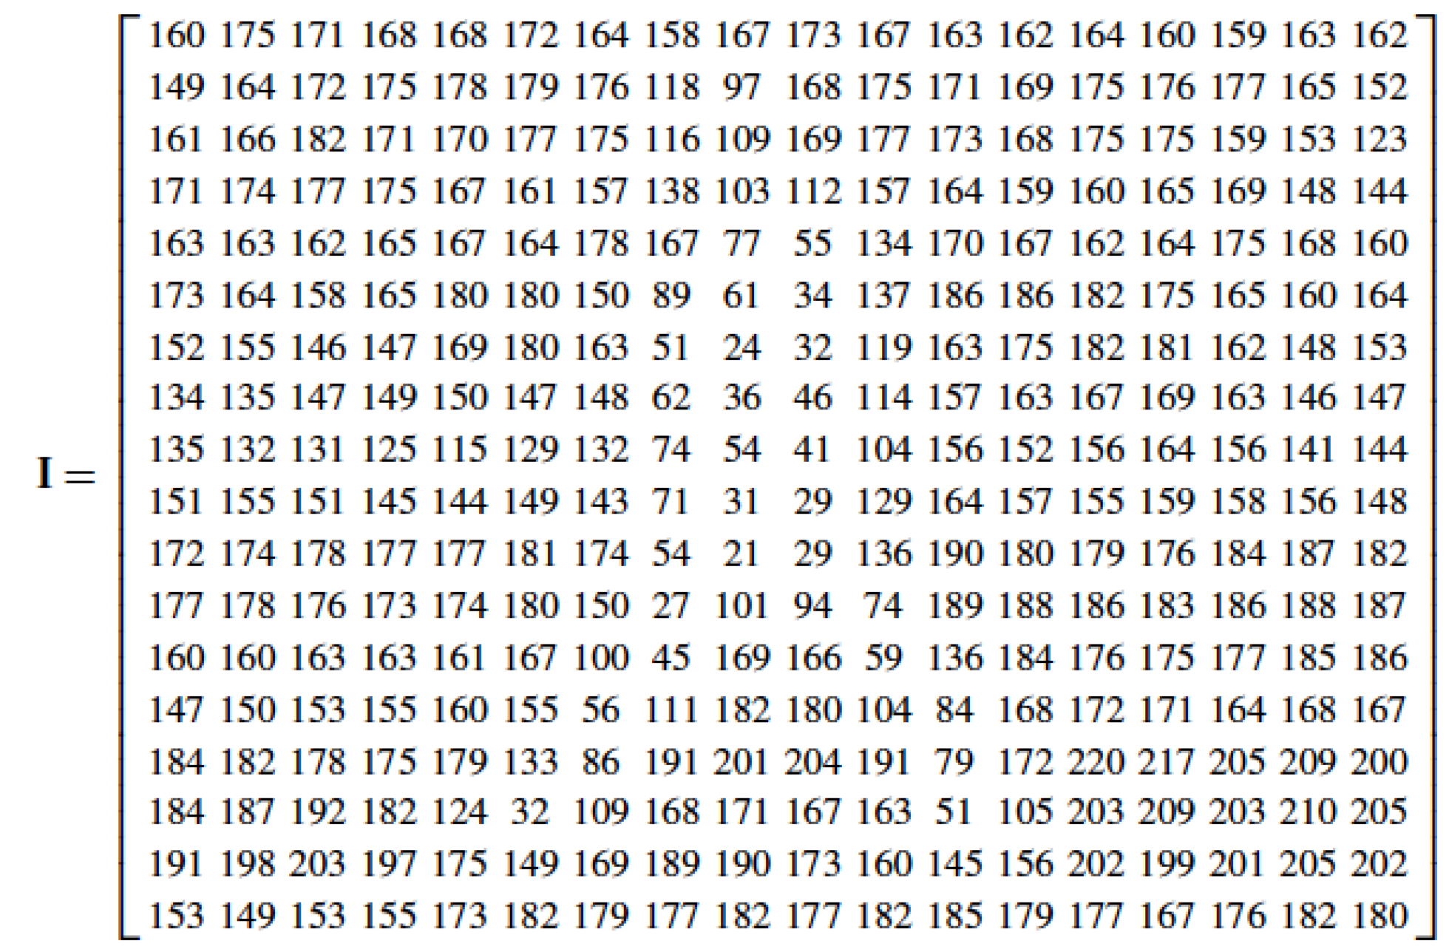
The input
What the machine gets

Slide 8
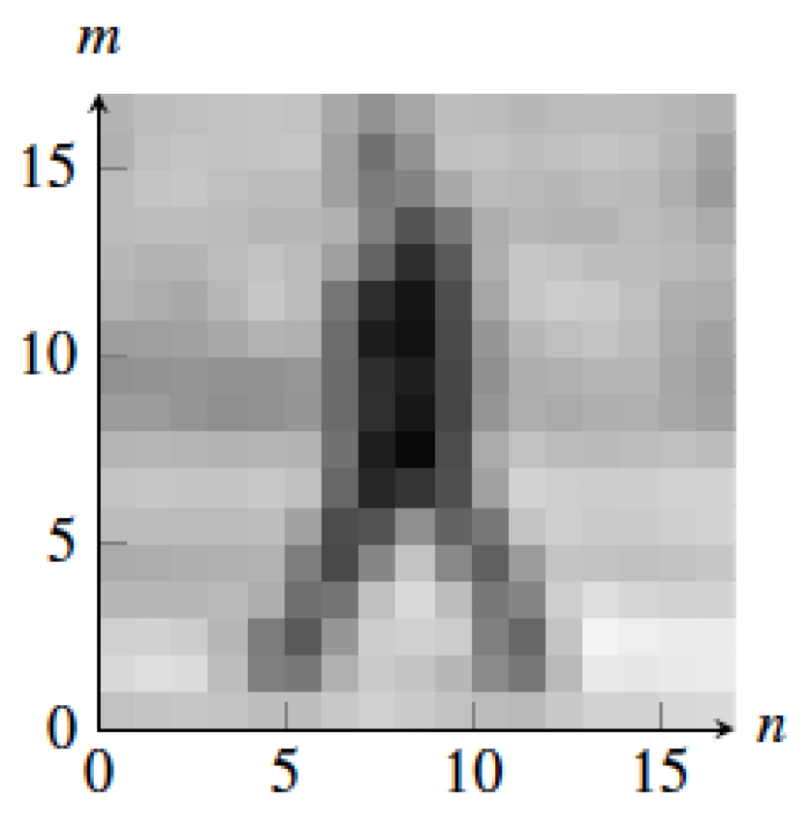
The input
What the machine gets
What we see
The camera is a measurement device, not a vision system

Slide 9
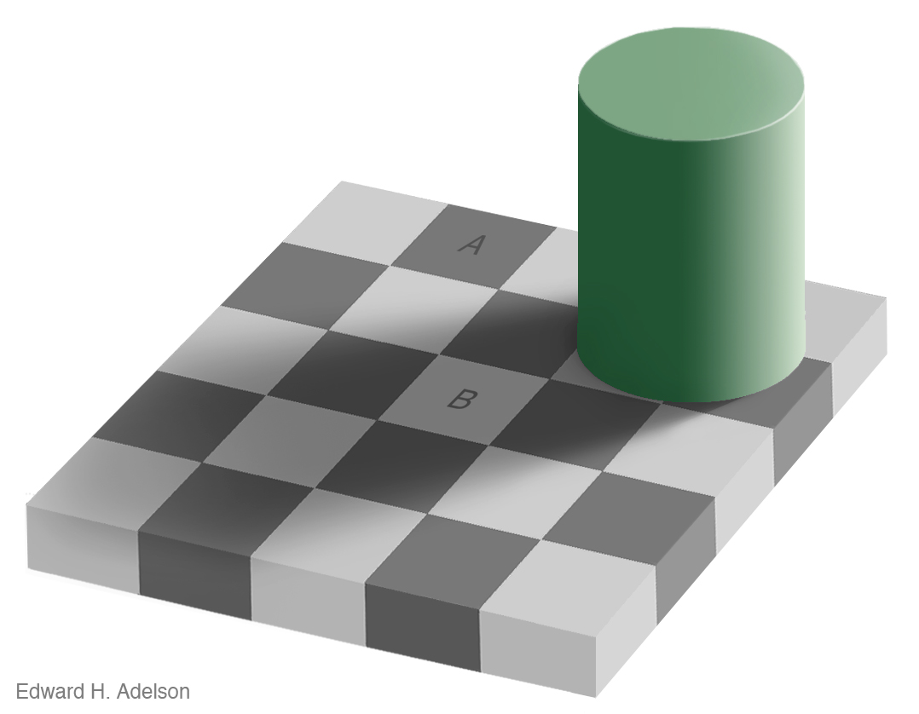
To see: perception vs. measurement

Slide 10
To see: perception vs. measurement

Slide 11
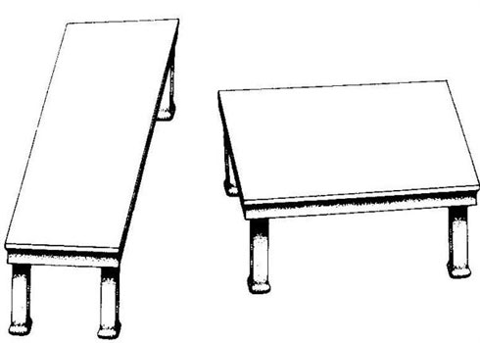
To see: perception vs. measurement
Depth processing is automatic, and we can not shut it down…
by Roger Shepard (”Turning the Tables”)

Slide 12
To see: perception vs. measurement
Depth processing is automatic, and we can not shut it down…
by Roger Shepard (”Turning the Tables”)

Slide 13
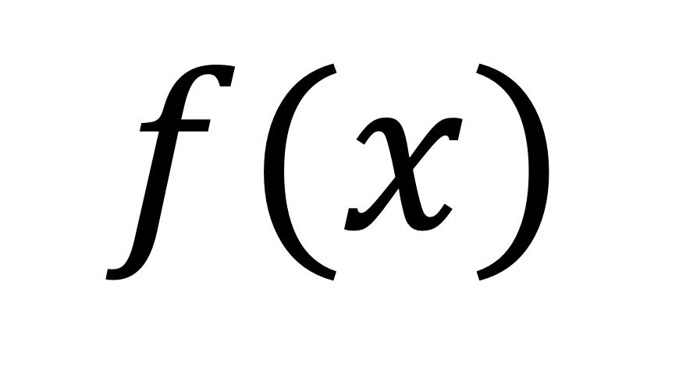

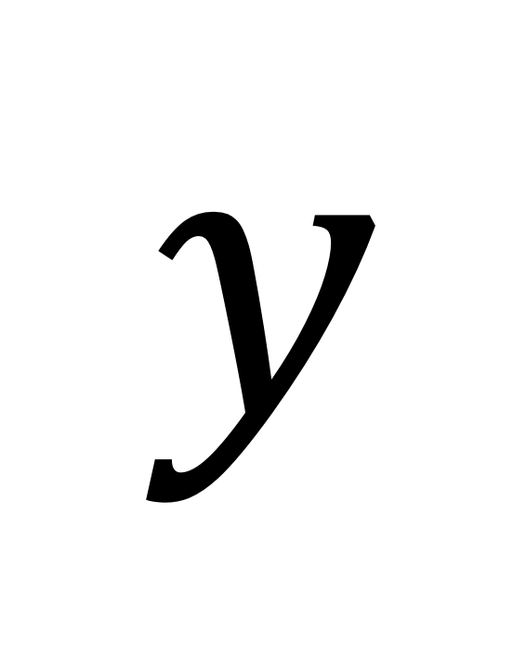
Tasks: generic formulation
$$y$$
$$x$$
$$f(x)$$
Image / Sequence
Labels
Image/sequence

Slide 14
Tasks: what humans care about

Slide 15
Tasks: what humans care about
Verification: is this a building?
Recognition: which building is this?

Slide 16
Tasks: what humans care about
Image classification: list all the objects present in the image
Building
Grass
People
Trees
Sky
Columns
…

Slide 17
Tasks: what humans care about
Scene categorization
Outdoor
Campus
Garden
Clear sky
Spring
Group picture
…

Slide 18
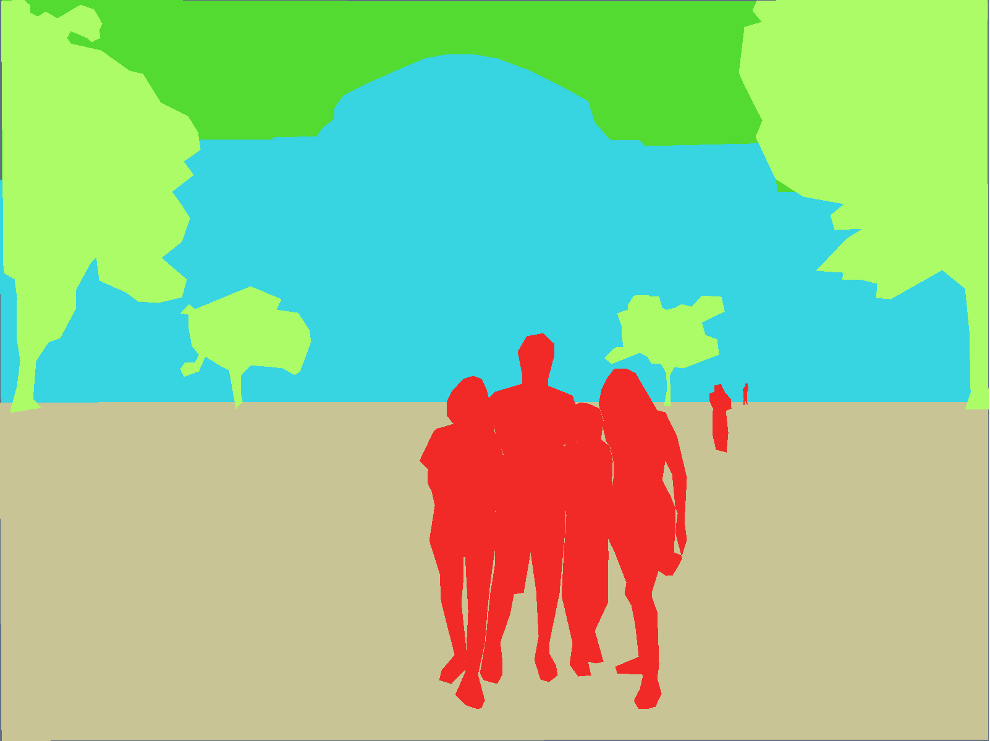
Tasks: what humans care about
Sky
Semantic segmentation: Assign labels to all the pixels in the image
Tree
Building
People
Grass
Related tasks:
Semantic segmentation
Object categorization

Slide 19
Tasks: what humans care about
Detection: Locate all the people in this image

Slide 20
Tasks: what humans care about
Recognition: who is this person?

Slide 21
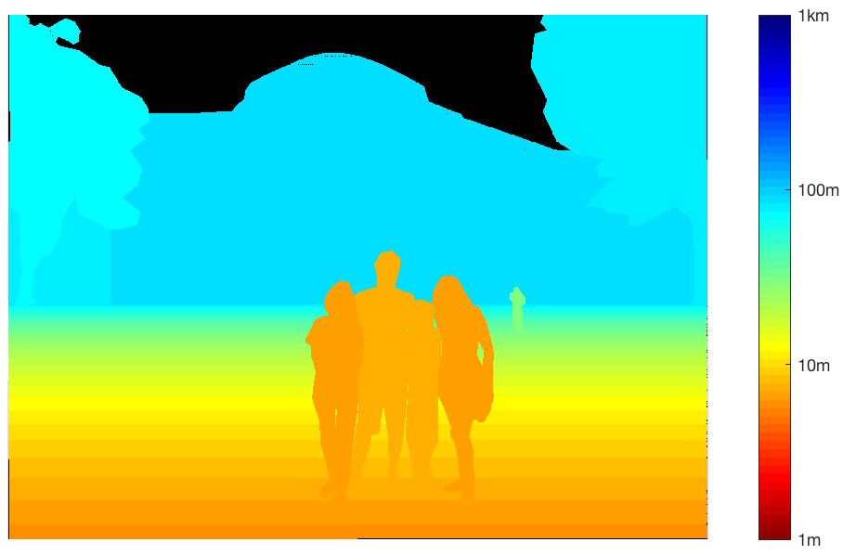
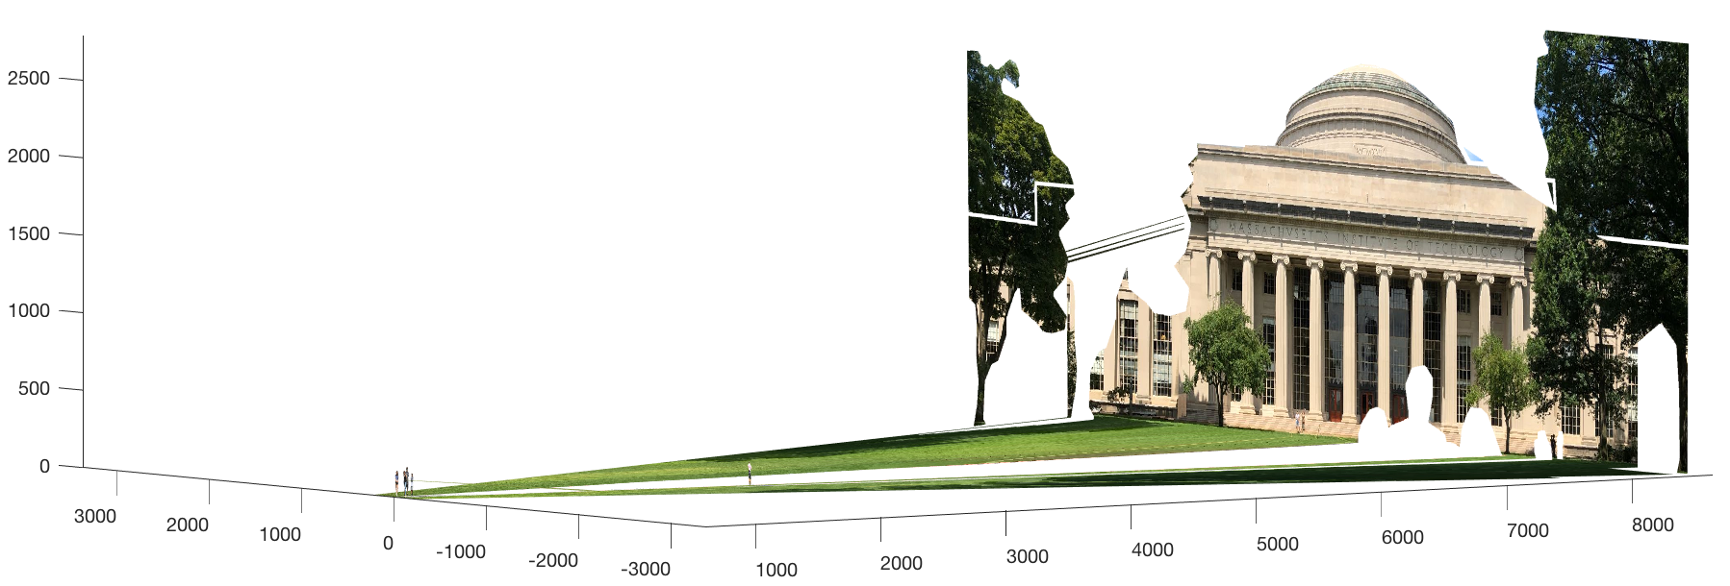
Tasks: what humans care about
Rough 3D layout, depth ordering

Slide 22
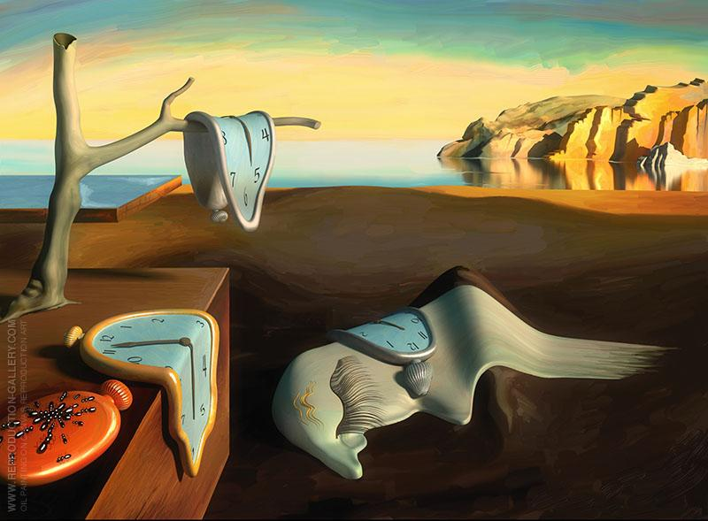
Tasks: what humans care about
Making new images

Slide 23

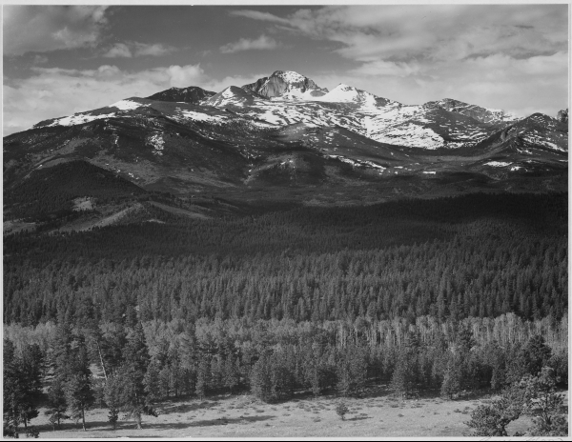
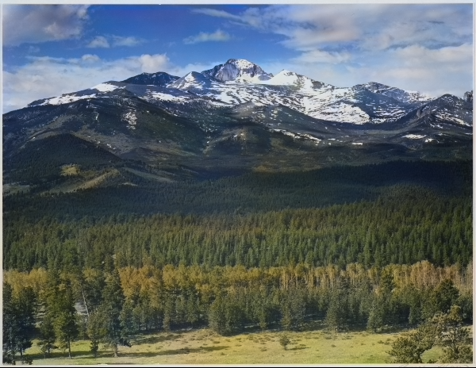
Tasks: what humans care about
Adding missing content
Input image
Colorized output

Slide 24
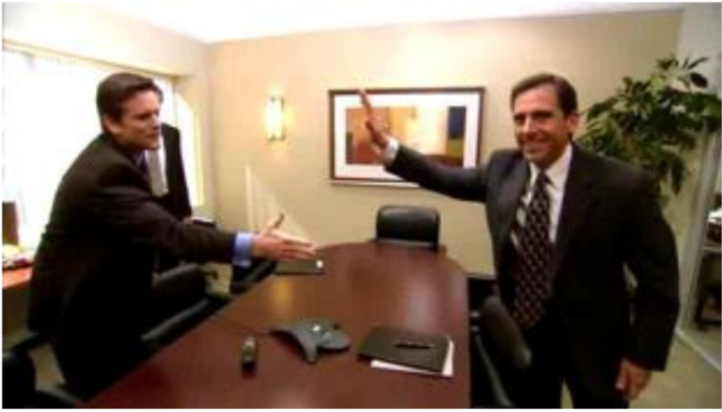
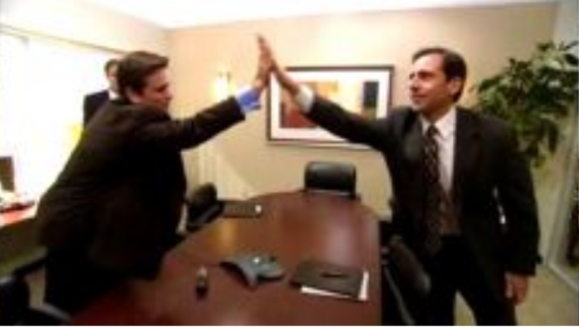
Tasks: what humans care about
Predicting future events
What is going to happen?

